Slide 1
Customer Churn Prediction
By, Emma, Jason and Sam.

Slide 2
Overview of Project
Predicting customer churn, or the likelihood that a customer will stop doing business with a company, is an important task for any business. By predicting churn, companies can take proactive steps to try to retain their customers and prevent them from leaving.
This can help to reduce the costs associated with acquiring new customers and can also help to maintain and grow the company's revenue.

Slide 3
Overview of Project
There are a number of techniques that can be used to predict customer churn, including machine learning algorithms ;
Logistic regression
Random Forest
K-Nearest Neighbour
To increase efficiency, you can use advanced algorithms;
XGBoost
LightGBM
CatBoost

Slide 4
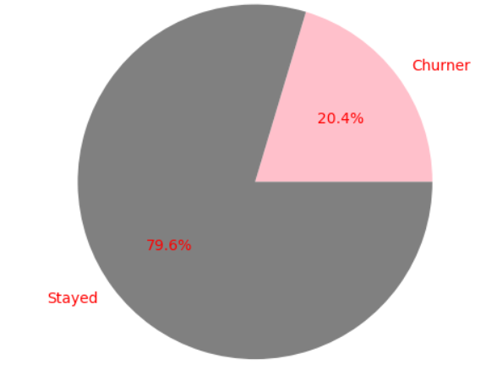
Our Data
DataFrame contains 10,000 samples with 14 features
Features included:
Geography (categorical)
Gender (categorical)
Age
Tenure
Balance
Number of products
Credit card or not
Active or not
Estimated Salary
Credit score

Slide 5
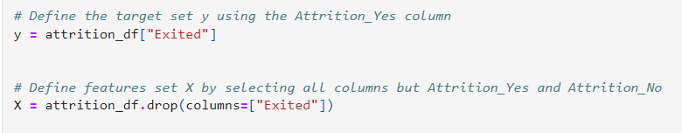
Data preparation
Data cleaning: checking null value use function of “isnull”
Combine both encoded features with original dataset as new dataframe called “attribtion_df”
Set out column “Existed” as target column, and the rest being X features

Slide 6
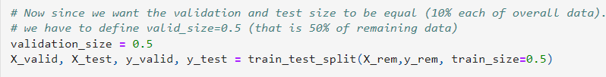
Training, Validation and Testing Sets
Using the function train_test_split from the scikit-learn library in Python. This function is used to split a given dataset into two subsets: a training set and a test set.
Step 1:
Step 2:

Slide 7
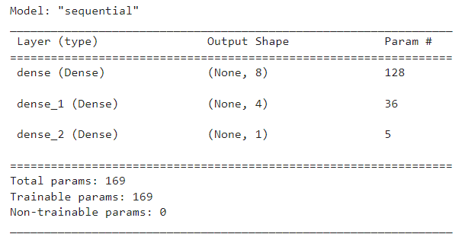
Model Structure
Neural Network
This code is creating a deep neural network model with two hidden layers using TensorFlow's Sequential model class.
The number of input features is determined by counting the columns in the training set.
The number of hidden nodes in the hidden layers are calculated using the mean of the number of input features and the number of output neurons, and the floor division operator (//). The model is then displayed using the summary method.

Slide 8
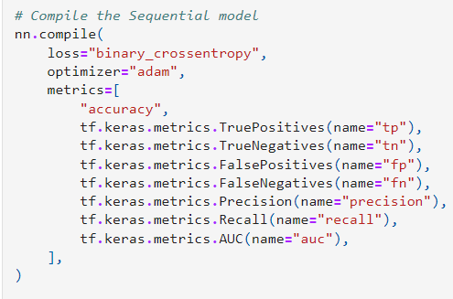
Compiling the Model
Neural Network
We compile the Sequential model using loss function of ‘binary_crossentropy’, the ‘adam’ optimizer, and the various metric.
The loss function of ‘binary_crossentropy’ is used for binary classification problem;
‘Adam’ is a popular optimisation algorithm for training nn;
In this case, metric “Recall” is what we will be compared against other model.

Slide 9
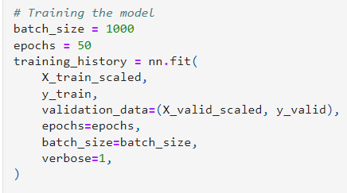
Training the Model
Neural Network
We train model using scaled training dataset, and tuning with validation dataset.

Slide 10
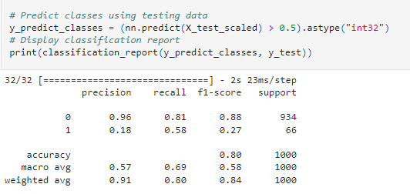
Evaluating the model
Neural Network
This problem is a typical classification task, the use of recall (i.e. ratio of true positive prediction made out of total positive cases in the dataset) as performance metrics are more relevant in this case, since correctly classifying elements of the positive class (customers who will churn) is more critical for the bank.

Slide 11
Logistic Regression Model using training data
Logistic Regression Model
We imported the LogisticRegression module from the sklearn library and instantiated a Logistic Regression model using the LogisticRegression class. We set the solver parameter to 'lbfgs' and the random_state parameter to 1. We then fit the model to the training data using the fit method of the LogisticRegression class, passing in the training data and the target variable.
Finally, we used the testing data to make predictions using the predict method and stored the predictions in a variable called "predictions".

Slide 12
Calculate accuracy score, Generate a confusion matrix and print the classification report
Logistic Regression Model
The results show that the model has an accuracy of 0.5789, with a precision of 0.82 for predicting when an employee will leave and a precision of 0.58 for predicting when an employee will stay.
The model also has a recall of 0.96 for predicting when an employee will leave and a recall of 0.19 for predicting when an employee will stay.
The f1-score for predicting when an employee will leave is 0.89 and the f1-score for predicting when an employee will stay is 0.29.
The support for predicting when an employee will leave is 1991 and the support for predicting when an employee will stay is 509.

Slide 13

Using the RandomOverSampler to resample the data
Logistic Regression Model
We used the RandomOverSampler module from the imbalanced-learn library to resample the data and balance the labels. We instantiated the random oversampler model, set the random_state parameter to 1, and fit the original training data to the model. We then counted the distinct values of the resampled labels data and confirmed that the labels now have an equal number of data points.

Slide 14
Using the LogisticRegression classifier and the resampled data to fit the model.
Logistic Regression Model
First, we instantiated the Logistic Regression model and set a random_state parameter of 1. Then, we fit the model using the resampled training data and made a prediction using the testing data. The resulting predictions were stored in a variable called resampled_predictions.

Slide 15
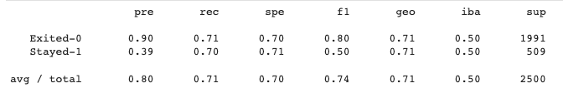
Evaluating the model
Logistic Regression Model

Slide 16
Modeling using Random Forest
Modeled using Random Forest classifier with 500 estimators
Trained model on X_train_scaled and y_train data
Made predictions on X_test_scaled data

Slide 17
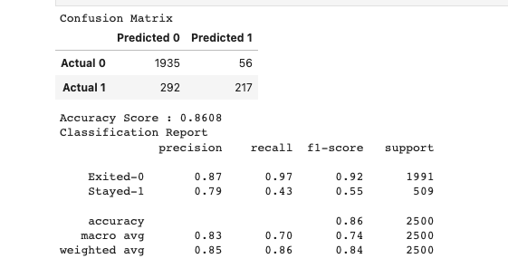
Modeling using Random Forest
Confusion matrix showed 1935 predicted "Exited-0" and 217 predicted "Stayed-1" correctly, and 56 and 292 predicted incorrectly, respectively
Accuracy score of 0.8608
Classification report showed precision, recall, and f1-score for both "Exited-0" and "Stayed-1" classes

Slide 18
Modelling using K-Nearest Neighbors
We trained the KNN model using 3 neighbors and the training data
We made predictions on the test data using the trained model
The model's performance was evaluated using a confusion matrix and a classification report
The model had an accuracy of 81% and a macro average f1-score of 65%

Slide 19
Modelling using XGBoost
Used XGBoost to model customer churn data
Trained model with training data
Made predictions using test data
Evaluated model performance with confusion matrix and classification report
Model had 85% accuracy with 85% precision for predicting customer churn

